Slide 1
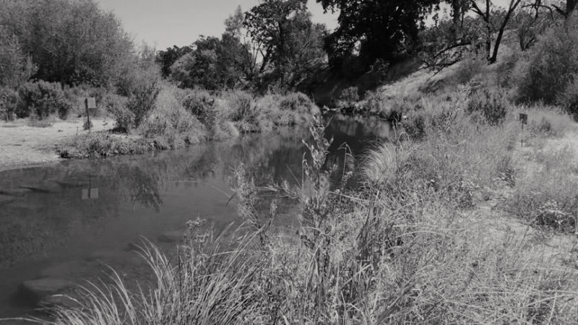
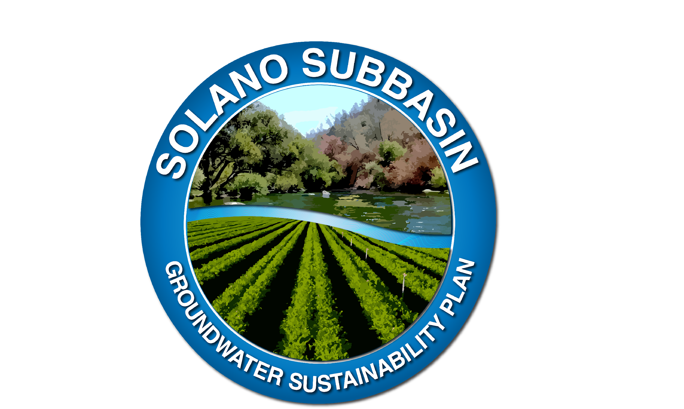
Rio Vista City Council
April 18, 2023
Welcome to the
Solano Subbasin
Chris Lee
Solano County Water Agency/Solano Groundwater Sustainability Agency
Notes:
Good evening Mayor Kott, Council members, Manager Carter, Staff, ladies and gentleman.
My name is Chris Lee, I work for the Solano County Water Agency and I also represent the Solano Groundwater Sustainability Agency.
I would like to give you an overview of Solano Subbasin Groundwater Sustainability Plan, the agencies involved in its implementation, and the current state of the subbasin.

Slide 2
California SGMA Requirements
Maintain a Functioning GSA
(Budget and Staffing)
Conduct Annual GW Monitoring and Reporting (each April)
Ongoing GSA Coordination/Outreach
Prepare/ Approve Five-Year GSP Updates
Notes:
Up until the Sustainable Groundwater Management Act became effective on January 1, 2015, all previous groundwater legislation was voluntary.
I do apologize for the acronyms. I will be using SGMA or Sustainable Groundwater Management Act, GSA or Groundwater Sustainability Agency, and GSP or groundwater sustainability plan a few times tonight.
What SGMA required was that a GSA or Groundwater Sustainability Agency, or multiple GSAs develop a GSP or groundwater sustainability plan to manage local groundwater basins.
And these GSAs have to fund themselves. The State is not helping with that.
A large part of the implementation of these GSPs is to monitor groundwater conditions and put together annual reports to the Department of Water Resources.
We recently submitted our second annual report a few weeks ago.
We are also required to provide continuous outreach and education on groundwater issues…
And then do comprehensive updates to the GSP every 5-years.

Slide 3
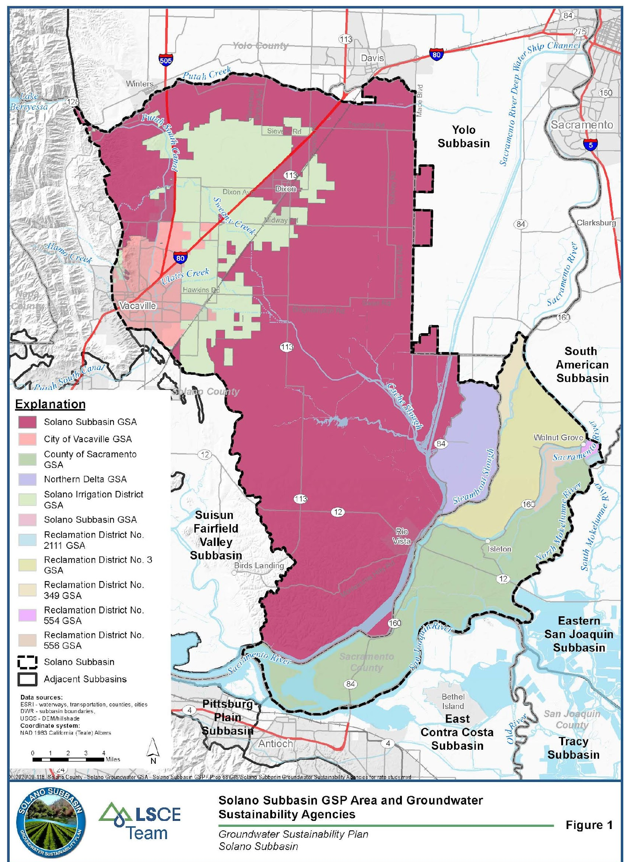
Solano Subbasin is Comprised
of Multiple GSAs​
Solano
GSA
Groundwater Sustainability Plan (Plan Area)
Find out if you are located in the Solano Subbasin: solanogsp.com/solano-subbasin/
Notes:
Solano County has 3 different groundwater subbasins in it.
The Solano Subbasin is what is considered a medium priority subbasin and subject to SGMA and why we had to develop a GSP.
It covers essentially the eastern half of the county.
And it actually extends into Sacramento County and a bit into Yolo County.
Both of those counties have developed their own GSPs and we coordinate with their staff on a regular basis.
We have a website: www.solanogsp.com, where you can find out about everything we have done to date essentially.

Slide 4
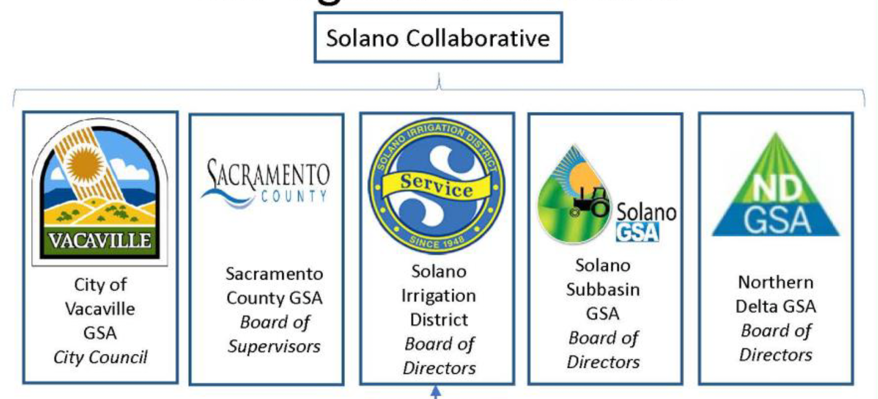
Independent Reclamation District (RD) GSAs; RD 3, RD 349, RD 555, RD 556, RD 2111, RD 317
Notes:
When we first started talking about SGMA about 7 years ago, we wanted to see if we could create a single GSA for the subbasin.
That didn’t quite work out.
What we ended up with were 5 separate GSAs, the City of Vacaville GSA, the Sacramento County GSA, the Solano Irrigation District GSA, the Northern Delta GSA, and the Solano GSA, which is includes the Cities of Rio Vista and Dixon, Solano County Supervisorial Districts 4 and 5, the Dixon and Solano RCDs, Cal-Water Dixon, the Solano Farm Bureau, Maine Prairie Water District, Reclamation District 2068, and a member of the Solano County Ag Advisory Committee. I think more than half of those Board members are either growers or ranchers.

Slide 5
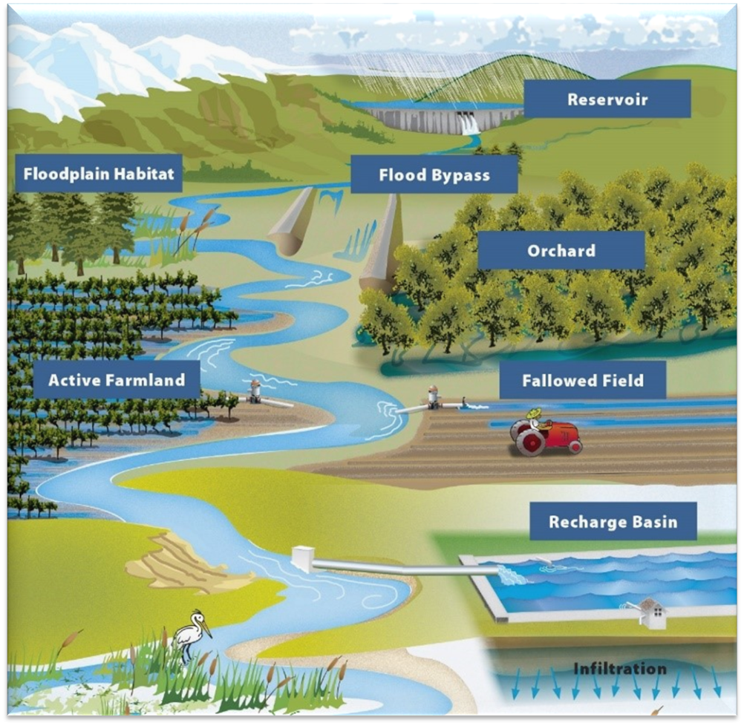
GSP Implementation: Ongoing Activities
Annual Reports and Five-Year Updates
Tracking Groundwater Conditions
Projects and Management Actions
Outreach
Grant Opportunities
Infiltration
Notes:
There is quite a bit we are required to do by the state to implement the GSP.
As I mentioned earlier, we have to submit annual reports by April 1st of each year..
And then comprehensive updates to the plan every 5 years.
We have to monitor and record groundwater levels, groundwater quality, thinks like subsidence, all to make sure we are not hitting any undesirable results, which would cause corrective actions.
We are also doing a lot of outreach, including an upcoming Town Hall meeting to take a closer look at current groundwater conditions, probably on the evening of June 1st.
We are also looking at grant opportunities to help with some of the implementation costs and to also perhaps do some pilot project with willing landowners.

Slide 6
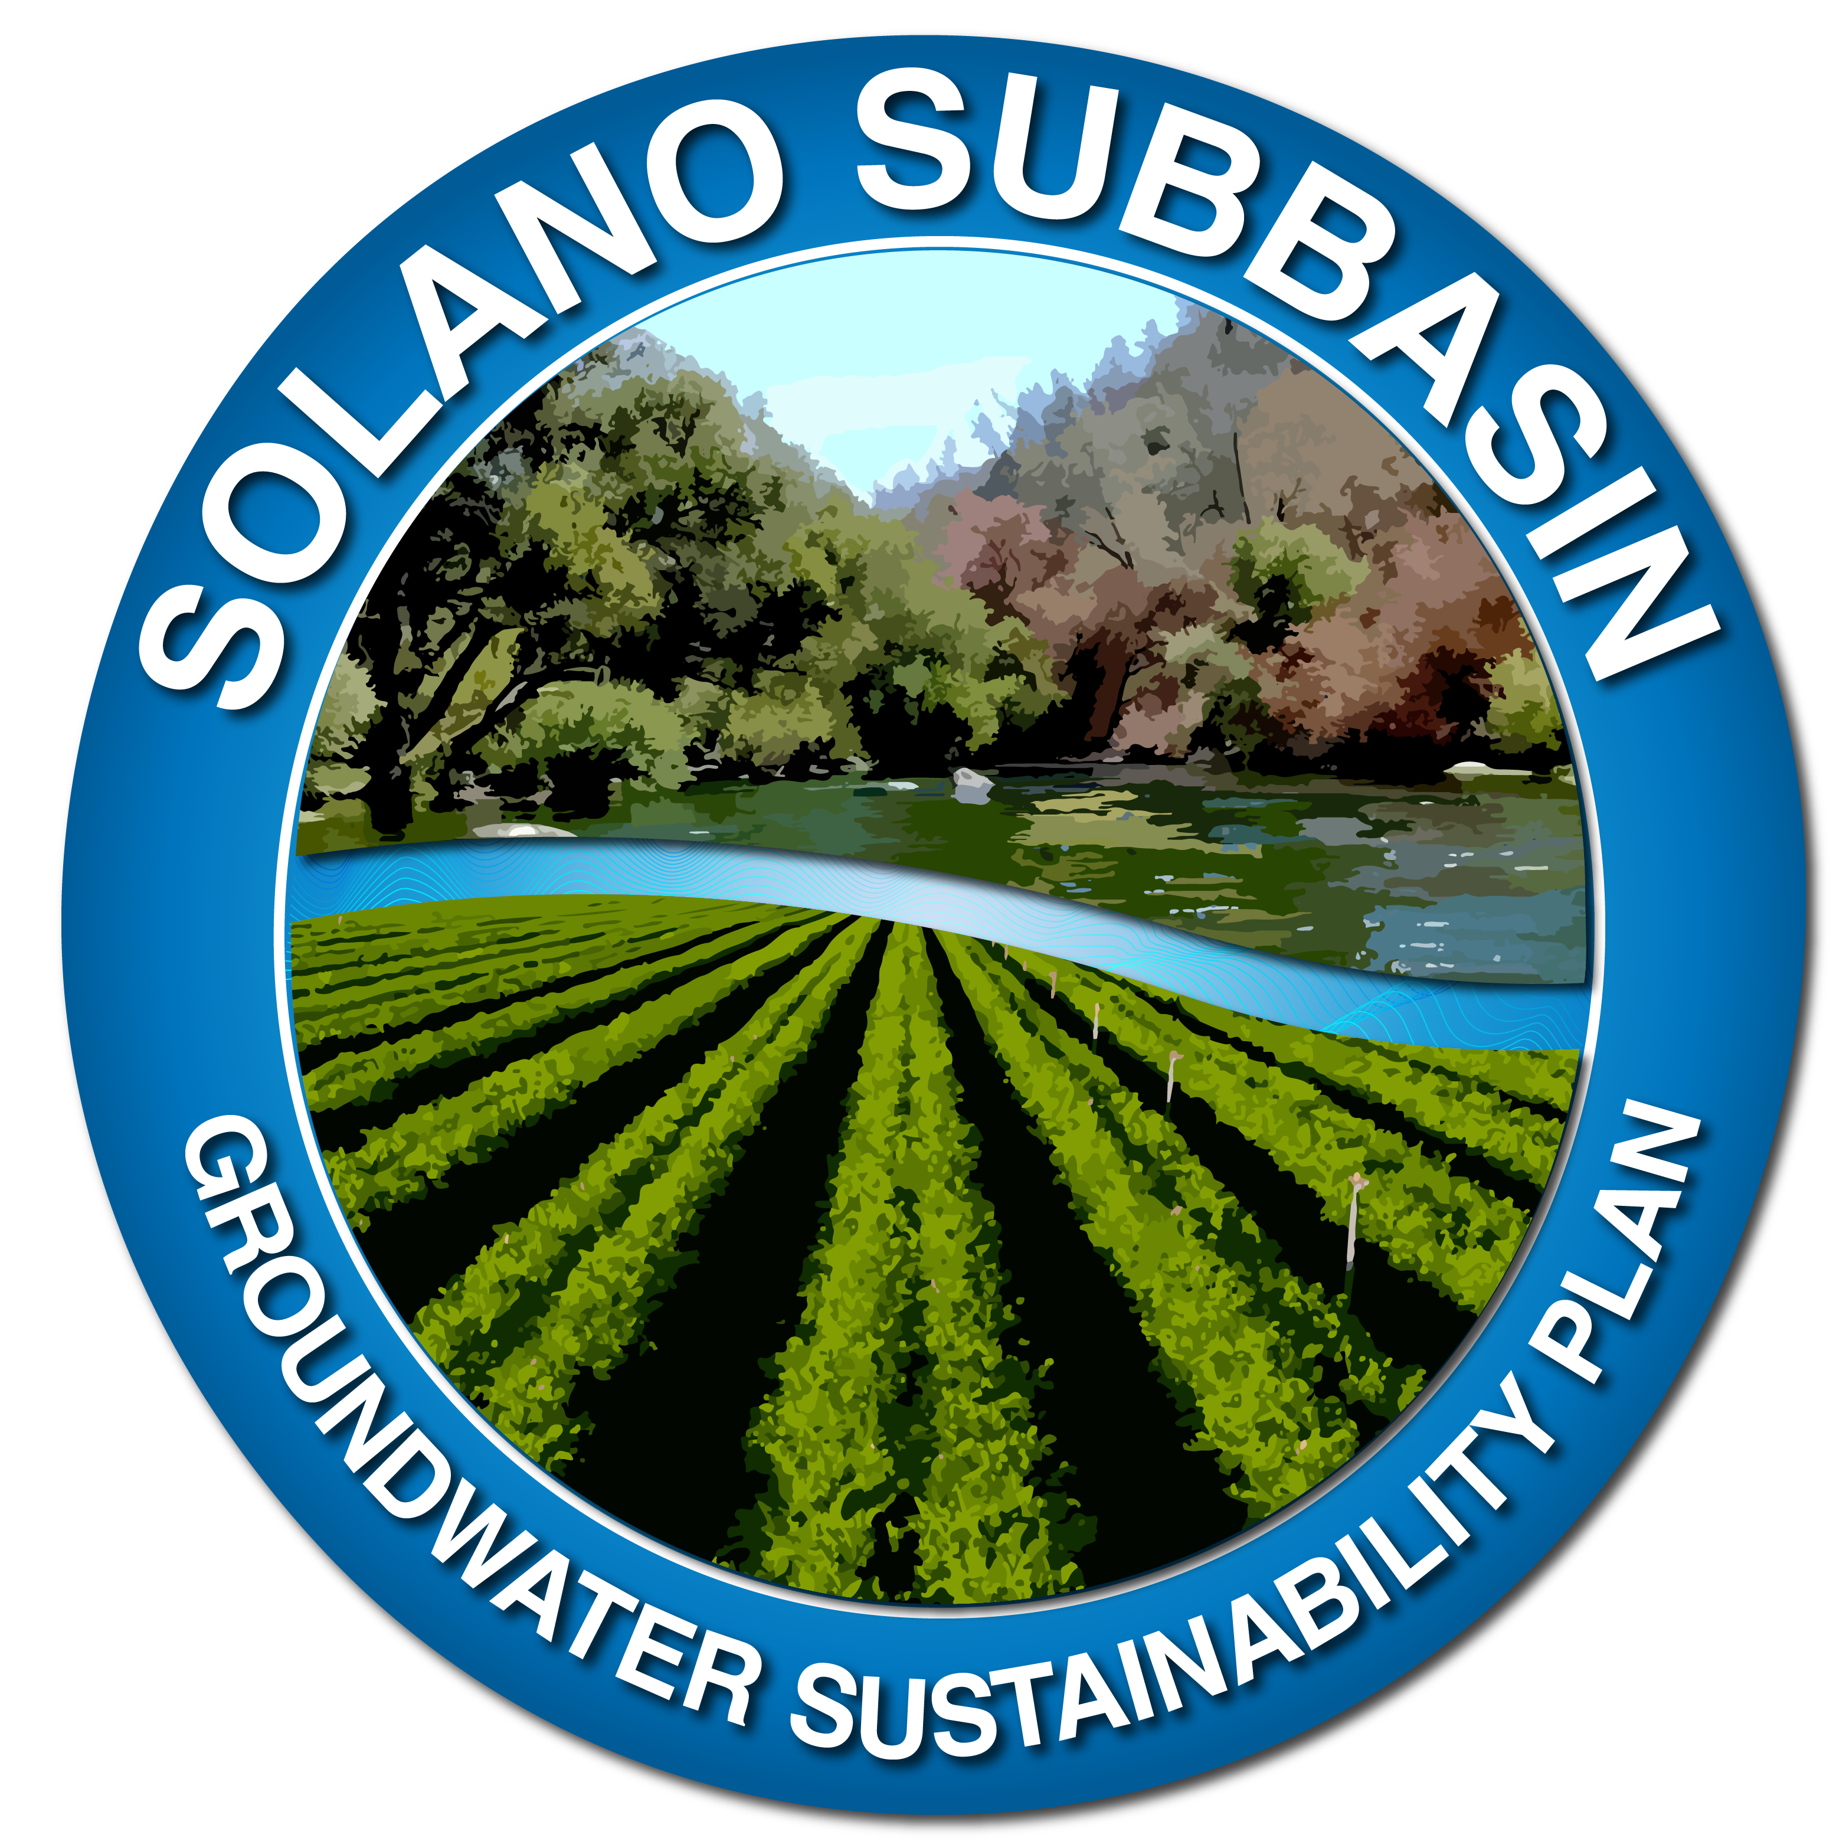
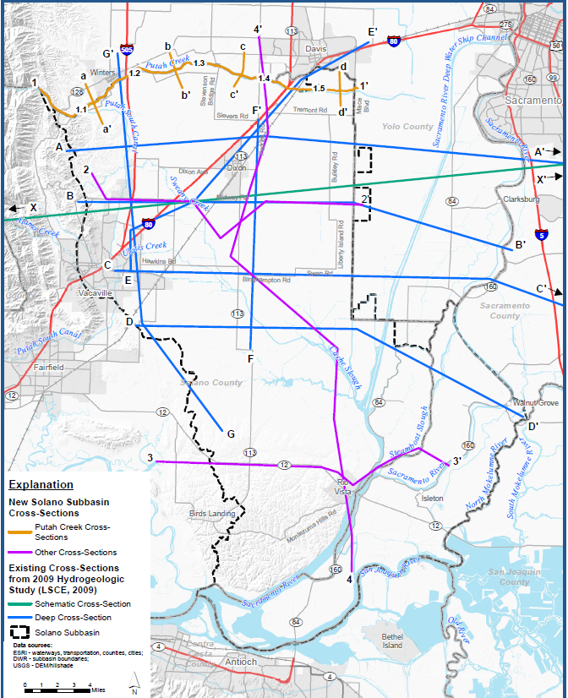
Hydrogeologic Conceptual Model
§ 354.14. Hydrogeologic Conceptual Model
Each Plan shall include a descriptive hydrogeologic conceptual model of the basin based on technical studies and qualified maps that characterizes the physical components and interaction of the surface water and groundwater systems in the basin.
Geologic Cross Sections (Key Component of HCM)
7 prior cross sections focused on deeper conditions
8 new cross sections to enhance HCM
5 shallow sections along Putah Creek
3 across northern and southern areas of Subbasin
Lithologic & Geophysical Logs: Characterize Subsurface Sediments to Depths >2500 Ft
Notes:
The good news is that we have a pretty good handle on what groundwater conditions looks like in the subbasin.
We have a fairly robust Hydrogeologic Conceptual Model.
All these lines you see across the map are cross sections of the subbasin where we have taken information from well logs and pieced together what are subbasin really looks like.
We have some monitoring wells that go down 2500 feet below the surface.

Slide 7
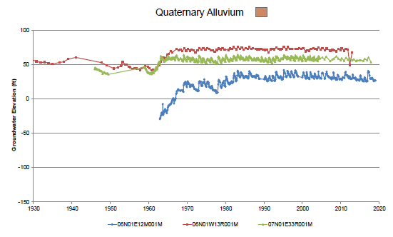
HCM and Groundwater Conditions
Previous Hydrogeologic Studies
Numerous Figures/Maps
Groundwater Data and Analyses
(historical by aquifer/depth zone)
GW levels (hydrographs; contours)
GW quality (key constituents:
TDS; nitrate; boron; arsenic; chromium 6)
Notes:
In general, we see a lot of hydrographs that look like this.
A generally straight line shows stability in groundwater levels.
We have seen some fluctuations over the numerous droughts we have seen the last few decades, but generally groundwater levels rebound fairly quickly, geologically speaking.
And we see seasonal changes every year, as the ag season starts up in the spring, we see groundwater levels go down some and then as the ag season tails off in the fall, we see groundwater levels rebound each year.

Slide 8
Water Budget Schematic: Preliminary
Surface Water System Water Budget
INFLOW
OUTFLOW
SURFACE WATER SYSTEM
OUTFLOW
Focus of Preliminary
Surface Water System
Water Budget
INFLOW
Surface Water/Groundwater Interface
EXCHANGE
GROUNDWATER SYSTEM
-
INFLOW
OUTFLOW
Notes:
In the GSP, we have had to put together some fairly sophisticated water budgets to show how we will manage the subbasin in a sustainable manner.
This is a simplistic cartoon depicting our surface water budget.
Essentially we have to look at all of the inputs, precipitation, surface water flows through creeks and those outlflows leaving the subbasin…
And then groundwater inflow and outflow as well as the interactions between surface water and groundwater.

Slide 9
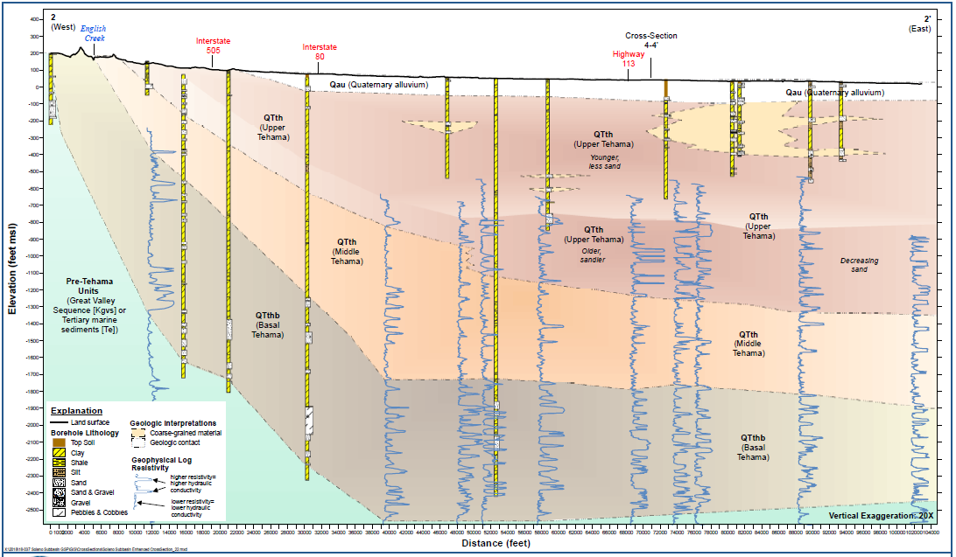
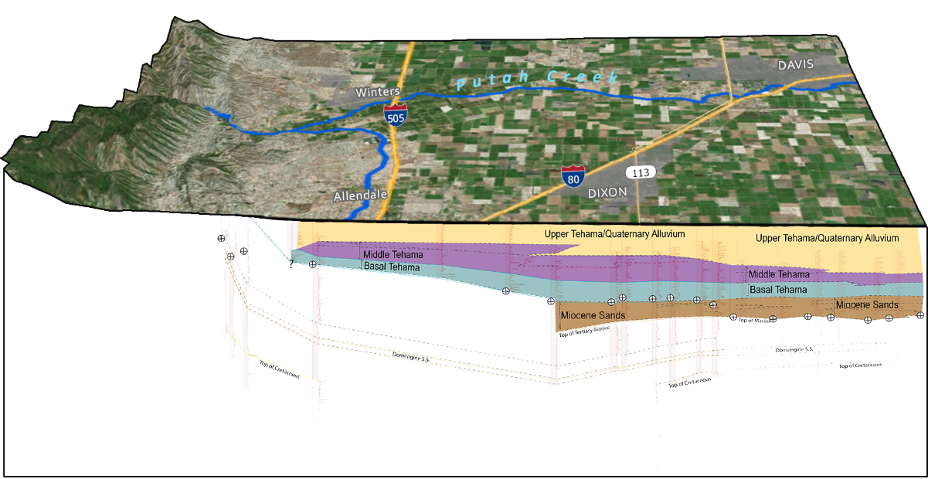
Geologic Cross Section-2-2’
West
East
Plan Area, Subbasin Setting & Water Supplies
UNCONFINED
.
Upper
Tehama
Plan Area, Subbasin Setting & Water Supplies
(Ch 1-5)
Sustainable Management Criteria & Monitoring
SEMI-CONFINED/CONFINED
Middle
Tehama
CONFINED
Basal
Tehama
Submit GSP to DWR: January 31, 2022
Notes:
And when you really take a look under the hood, the picture of the subbasin is pretty complicated.
The Solano Subbasin has basically three main layers.
The upper Tehama formation is where the vast majority of groundwater is pumped from, these well are near the surface down to about 400 feet.
Then there is the Middle Tehama, where only a few of the larger ag operations pump from in the 400-600 foot deep range.
And then the much deeper Basal Tehama formation, where only the City of Vacaville has and production pumps at.

Slide 10
Solano Subbasin – Long-Term Funding Strategy
SGMA Timeline
January 2022 GSAs adopt GSP and submit GSP to DWR
June 2017
Form GSA
2042
Achieve Sustainability
Maintain sustainability for 50 years
GSP Development
GSP Implementation
You are here
Notes:
We have made it past the first major hurdles, forming the GSAs and submitting the GSP to DWR on time.
DWR has up to two years to review our GSP.
Now that we are implementation mode, we have 20 years to show the state that we can get to managing our subbasin in a sustainable manner.
Again, I think we are already doing that.
And we have to obtain funding to make sure we continue to do all the monitoring and reporting and managing of this subbasin, in perpetuity.

Slide 11
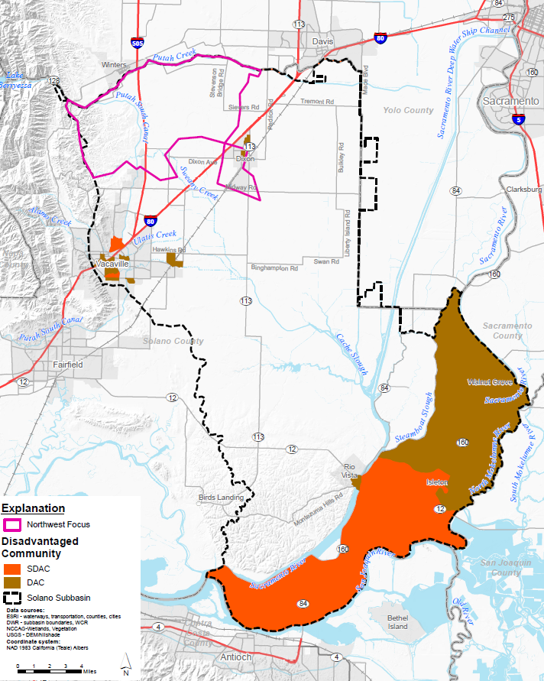
Northwest Focus Area
Notes:
Looking at the entire subbasin, we are not required to do any projects or management actions to rectify and deficiencies or undesirable results.
We do have an area of the subbasin, we are calling the Northwest Focus Area, that has seen some declines in groundwater levels of 10-20 over the last several decades.
So we want to take a closer look there to see if we can figure why that is happening and perhaps do some voluntary projects or management actions to see if we can make some positive changes.
Montezuma Hills-Fractured Rock

Slide 12
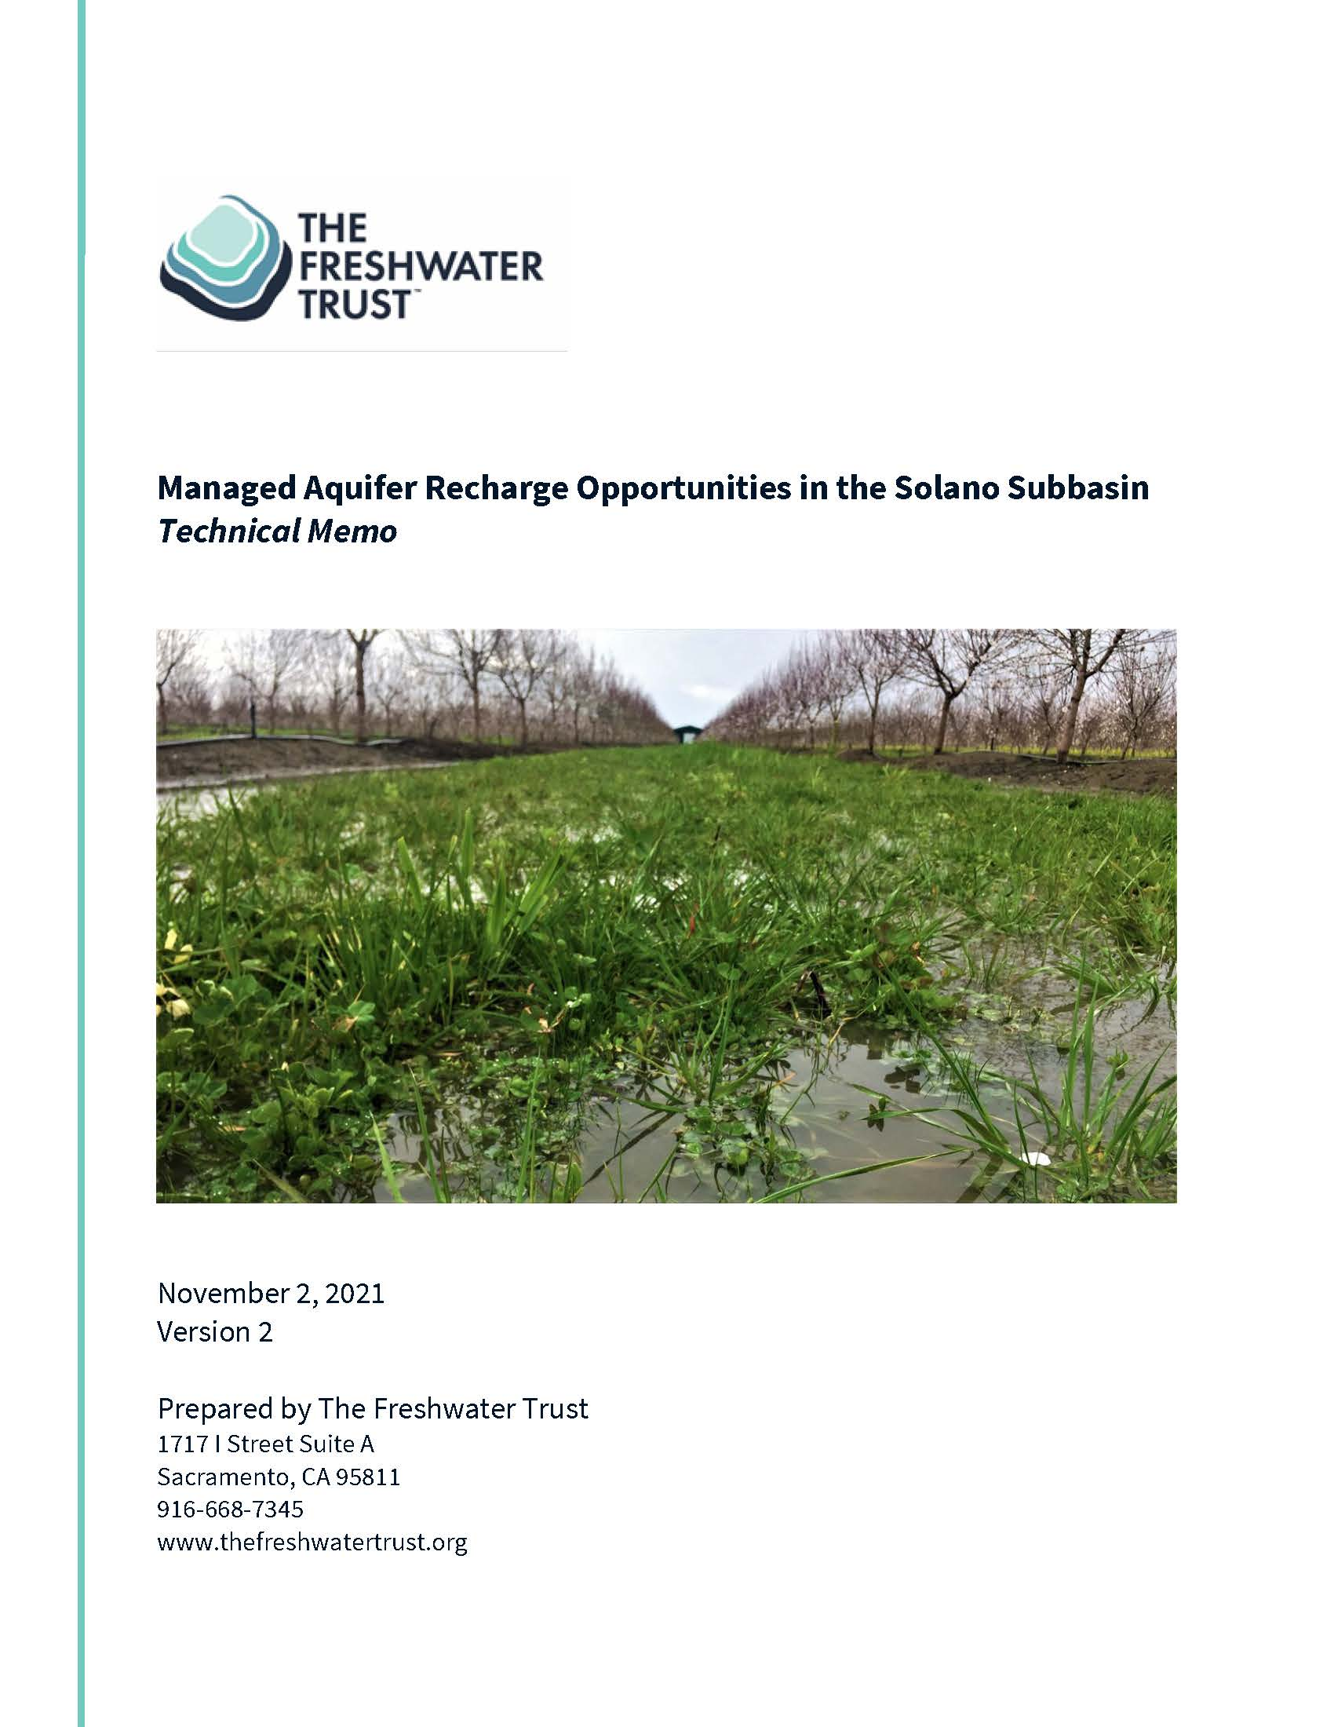
Technical Memos
Potential Projects-Managed Aquifer Recharge
Notes:
We have a several technical memos in the GSP and one of them details managed aquifer recharge.
I won’t go into great details on this as I believe the Council received a presentation about Managed Aquifer Recharge fairly recently.
In a nutshell, groundwater recharge and discharge are key water budget components of the subbasin.
Recharge occurs in the subbasin through infiltration and deep percolation from precipitation, applied water-such as irrigation for ag production, seepage from natural waterways, seepage from water conveyance systems, such as canals, and deeper subsurface recharge from adjacent and upland sources outside of the subbasin.
As mentioned earlier, this has all led to a pretty stable subbasin.

Slide 13
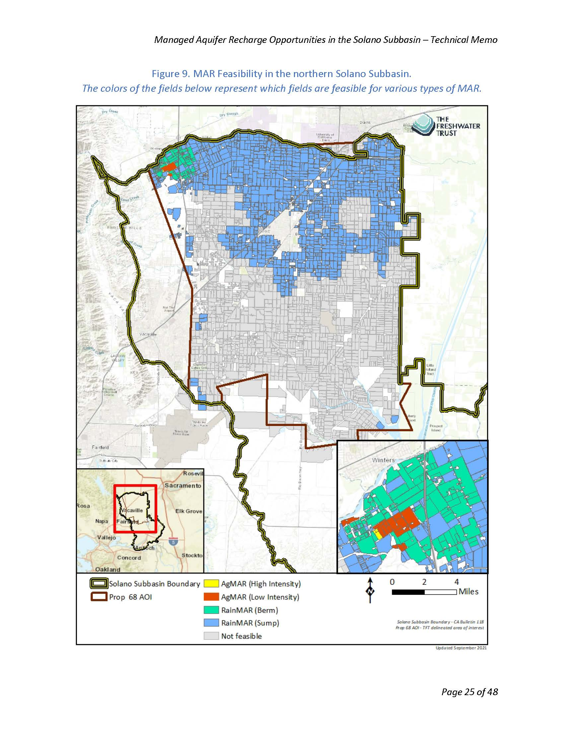
Potential Recharge Areas
Recharge Areas-Northwest Focus Area
Notes:
If we dive a bit deeper and look at that Northwest Focus area, it is actually in a part of the subbasin that is fairly conducive for recharge.
If were to secure funding, we could explore some type of managed aquifer recharge project to see if that would bring groundwater levels back up in some of these wells.
We will continue to look for funding for these types of projects and continue to reach out to landowners to see if they would be willing to do something on their land.
In reality, we would need a really large basin to have any impact on a subbasin of our size, at least several hundred acres in size, maybe even closer to a 1000 acres to really have any impact.
Again, looking at the subbasin as a whole, we are in really good shape and we show excess groundwater leaving the subbasin and that is why we are not required to do any of these types of project now.
But conditions can and likely will change-so we will continue to work to see if it makes sense to move forward with some type of recharge project if funding becomes available.

Slide 14
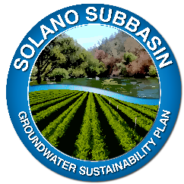
Multiple ways to stay involved
Ongoing outreach via:
Website: SolanoGSP.com
Newsletters
Press Releases
Town Halls
Events in partnership with RCDs
Individual GSA Board meetings
Work with beneficial user groups includes:
Projects and Management Actions
Inter-basin Coordination
Intra-basin Coordination
Tribes
Disadvantaged Communities
Notes:
There are many ways to stay involved in the process.
As I mentioned earlier, we have a pretty robust website.
You can go there and sign up for newsletter updates.
We have an upcoming Town Hall meeting.
We have met with many groups and given presentations and updates at their meetings…
And we will continue to work with all of the beneficial users groups in the subbasin on groundwater issues.

Slide 15
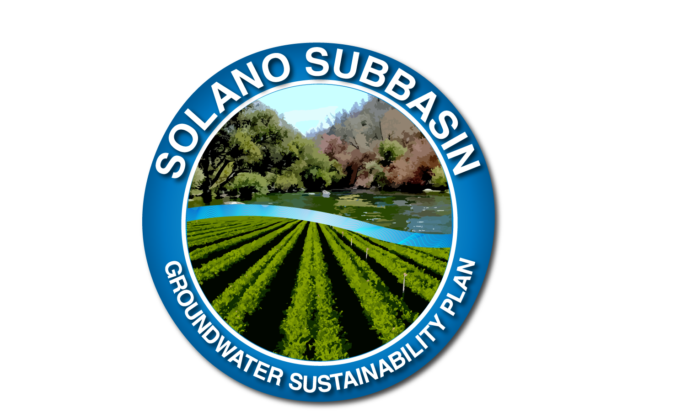
THANK YOU
Notes:
That was a look at a pretty high level of SGMA, the GSAs, and the GSP.
I would be happy to try to answer any questions you may have, thank you.

