Slide 1

Overview of the Proposed
Delta Conveyance Project
September 27, 2022
Misty Kaltreider
Solano County
Osha Meserve
Soluri Meserve
Delta Conveyance Project overview
Comparison between prior Conveyance/Tunnel Projects
Draft Environmental Document Status

Slide 2
State-Wide Water Project Challenges
19th Century Laws
Policies to encourage economic development
20th Century Infrastructure
Federal Reclamation Projects
State Water Projects
Municipal Provider Projects
21st Century Challenges
Urban Population Growth
Climate Change
Results
Fueled California Economy
All had unintended consequences
All are less reliable today
Shasta (1948)
Oroville (1961)
Folsom (1955)
Mokelumne
Aqueduct (1926)
Hetch Hetchy (1913)
CVP (1937)
LA Aqueduct (1908)
SWP (1960)
Colo. River Aqueduct (1933)
2
Notes:
California climate – most perception in the mts & northern portion of the state, whereas most population central/southern areas. Water projects developed to encourage economic development were built to move water to fuel growth.
The SWP is the largest State-built conveyance project in the US. On average the state delivers ~2MAFY to agricultural and municipal users through various water supply contracts mostly in central and southern California.
A companion Federal water project, Central Valley Project delivers ~1.76 MAFY to central valley farms & urban centers in the SF area.
However these larger fed & state water infrastructure projects developed around 19th century laws using 20th century infrastructure, are encountering critical challenges associated with environmental constraints, climate changes and over extension of demands on the infrastrucutrewhich are making theses systems less reliable.

Slide 3
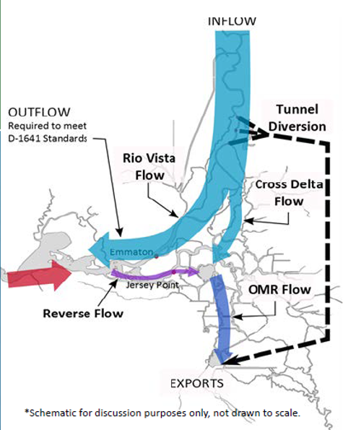
Delta Conveyance – What is it?
Delta tunnel project is the latest version of a massive State water infrastructure project to redirect Delta flows.
Previous names/programs associated with the concept:
Peripheral Canal (1940-1982)
CALFED (1990-2000)
Bay Delta Conservation Plan (2008-2014)
California WaterFix (2015-2019)
Delta Conveyance Project (Current)
**
**Old & Middle River (OMR)
3
Notes:
What is the Delta Tunnel?
Latest version of a massive state water infrastructure project – isolated conveyance (Tunnel)
Why is it important?
The project takes water that freshens the Delta and maintains the water quality and healthy ecosystem and diverts the fresh water under the delta (through the Tunnel) directly to export pumps in the southern part of the Delta, near Tracy. This water is then exported to users in central and southern California to the determent of the Delta.
This concept is not new but has been under different programs and projects for decades. A list of the various iterations is summarized here.
The most current version – Delta Conveyance Project, proposed construction and operation of a single underground tunnel that would divert millions of AF of freshwater that would otherwise flow naturally through the Bay-Delta.
According to project proponents, the goal of the project is to provide operational flexibility for water deliveries for its customers south of the Delta.
These massive changes ignore the impacts to the delta itself.
This diversion reduces freshwater outflows needed to maintain salinity from further migrating upstream.
This directly impacts the intakes used by Ag and the Solano County cities (Vacaville, Fairfield, Vallejo, Benicia and Travis AFB) that rely on the NBA. This would result in less water available for these users & higher costs to treat Delta water.

Slide 4
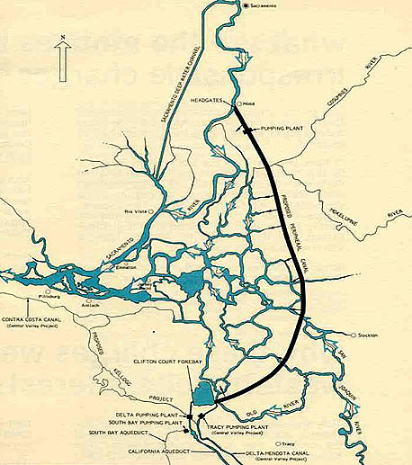
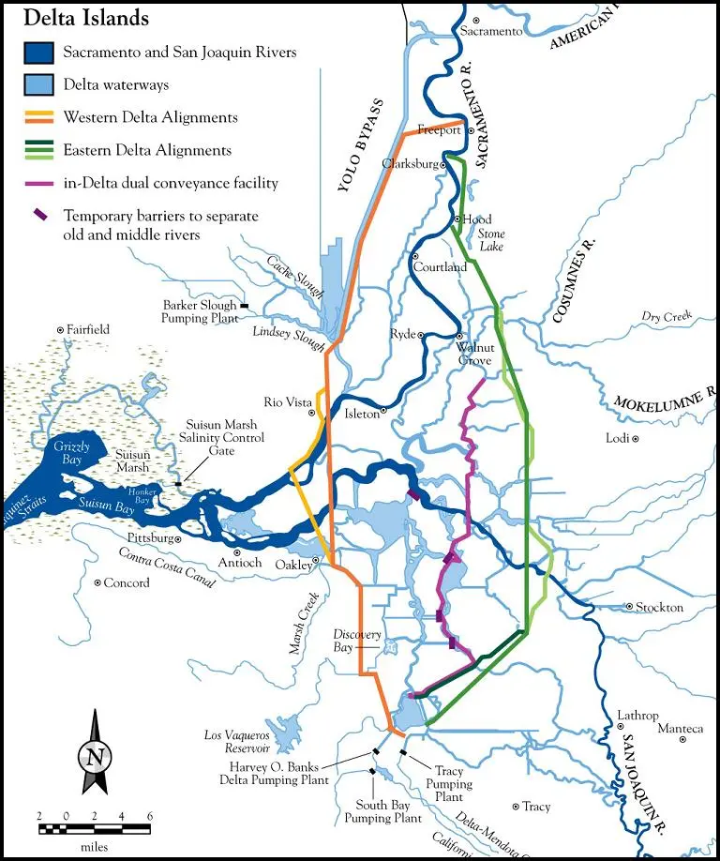
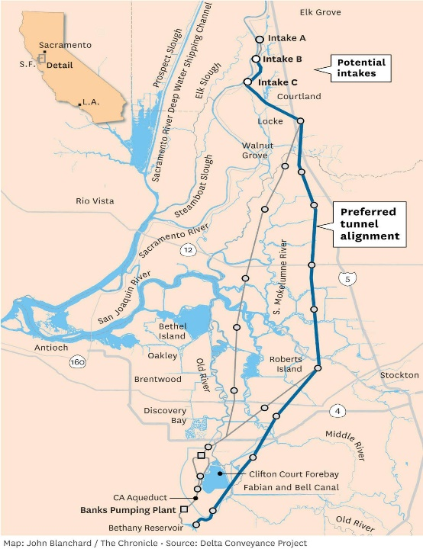
Delta Conveyance – Previous/Current Proposal Differences
 | Peripheral Canal (1982) | BDCP (2008) | Cal. Water Fix (2017) | Delta Conveyance Project (2022)
Conveyance | Open Isolated Channel (43 miles long) | Two Tunnels (35 miles long) | Two Tunnels (35 miles long) | One Tunnel (45 miles long)
Intakes | 1 near Hood | 3 (Hood, Clarksburg, & Courtland) | 3 (Hood, Clarksburg, & Courtland) | 2 (Hood) to 3 (Clarksburg)
Capacity | 23,000 cfs* | 15,000 cfs | 3,000 cfs/intake 9,000 cfs max. | 3,000 cfs/intake (6,000 cfs)
Alignment | East Delta | Central Delta | Central Delta | East Delta
4
*CFS: Cubic feet per second
Notes:
Comparison of the various Project proposals
Peripheral Canal – opposed by voters
Bay Delta Conservation Plan then revised into the California Water Fix
Latest – Delta Conveyance
All are similar – isolated conveyances that take fresher water in the northern delta & diverts directly to the pumping plants in southern delta
Bypassing the heart of the delta

Slide 5
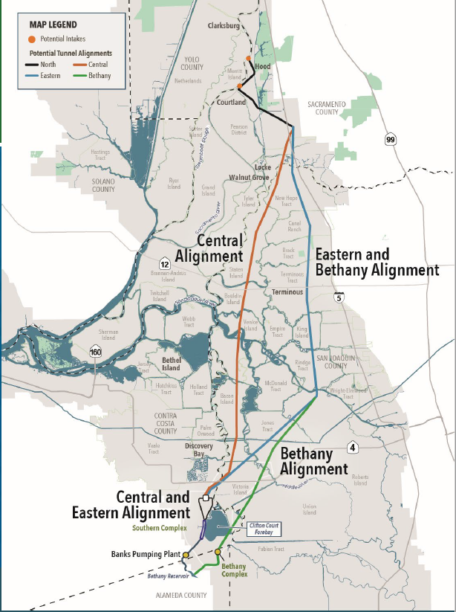
Delta Conveyance: Key Elements
Intakes: Divert water from two intakes in the Sacramento River near Hood & Courtland
Each intake is 150+ acres in area and ~ 1/4 mile long
Tunnel: 39-foot diameter concrete tunnel, 45 miles long, buried 150 feet under the Delta
Tunnel Alignments: Eastern / Bethany (DWR preferred)
Heavy truck trips on surrounding highways (I-5, I-12, 160) and local roads (almost 5 million truck trips)
Potential barge and other waterway impacts
13+ years of construction
Cost: Over $16 Billion
No new local water supplies
NBA
5
Notes:
Tunnel alternative routes for the project being considered by the State.
Project includes 2 intakes in northern Delta (Hood/Courtland), approx. ¼ mile long for each intake and approx. 2 miles apart.
The intakes include fish screens and designed to minimize fish impacts.
The intakes divert water into a single 39-foot outside diameter tunnel, drilled 150-190 feet below the delta extending over 45 miles from the northern part of the Delta to the southern pumping facilities.
Even with the proposed northern intakes, the southern intake facilities with their massive pumps will continue to operate as a “dual system”. As DWR has no plans to modernize the aging Clifton Court facilities. As such, this proposed system doesn’t effectively mitigate for fish loss in the southern delta.
– multiple surface accesses along each alignment,
- staging & material stockpiling areas each taking 150 acres or more.
Concrete batch plants, fuel station power stations and other facilities along the routes; of which (each comprising 100+ acres of farmlands).
Tunnel – two potential alignments with the Eastern/Bethany (alt 5) as DWR’s preferred route.
- Multiple launch/retrieval shafts requiring 400 acres each for equipment/storage/staging.
Many levee roads will be impacted; especially eastbound toward Stockton and I-5.
- detours along local roads & I-12 through Solano to avoid construction work
This project impact the delta directly without any benefits for local water supplies and the project costs over 16B and will take 13 years to construct with disruptions across 6 counties.

Slide 6
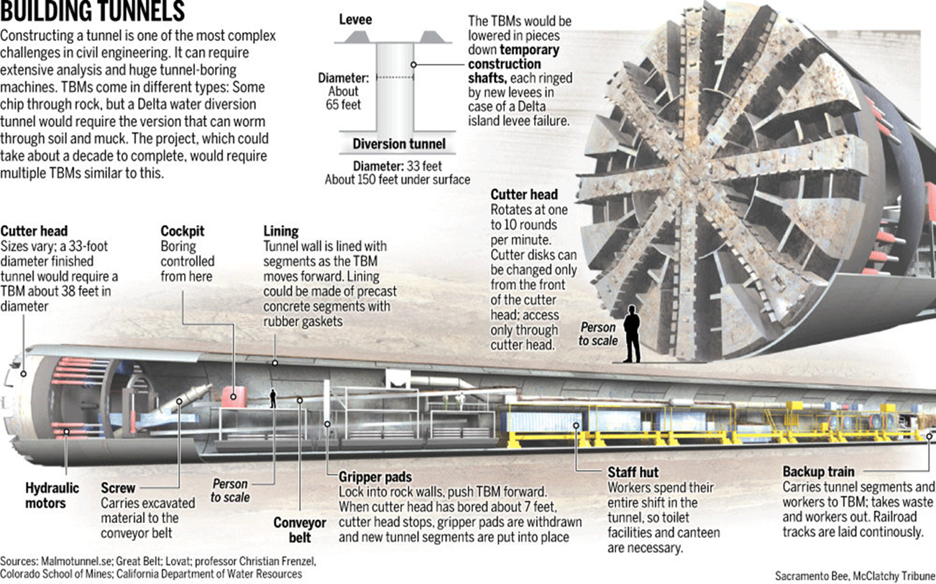
Delta Conveyance – Construction
6
Notes:
To construct the tunnel, the state proposes to use Tunnel Boring Machines.
This slide shows the scale of such machine.
Where you can see the person next to the large 39-foot diameter cutting head of the machine. For scale, its diameter is about the length of a school bus.
Image this drilling 150 feet under the delta for 14 years.
There could be up to 6 of the machines operating at the same time 24 hrs / day 365 days/year / 13 years.
The machine (20,000 hp) may take 6 months to drill each mile – (~40 feet / day)
Multiple (up to 6) machines operating at the same time – concerns: vibrations & potential impacts to existing levees & older communities, impacting natural gas lines & wells (abandoned) that are prevalent in the Delta area.

Slide 7
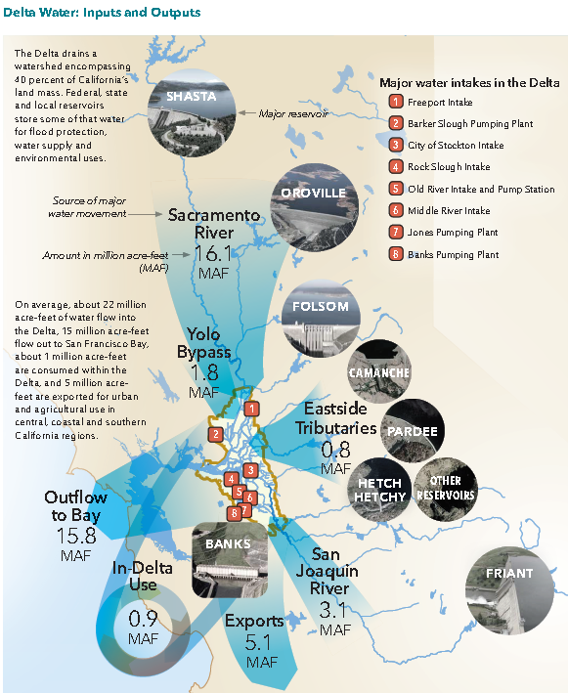

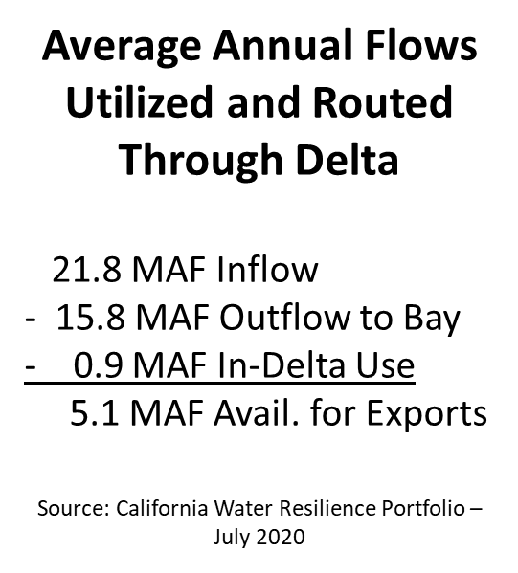

Flows and
Water Quality
7
Notes:
When you hear folks talk about California’s water system is an engineering marvel, this is what they mean.
The Delta drains a watershed that totals 40% of California’s water. Federal, State and local reservoirs store some of that water for flood protection, water supply and environmental uses.
In wet years – what is called “unimpaired” flow from the Delta to the Bay could exceed 50 MAF. In very dry years, it could be <10 MAF.
An AF provides enough water for 2 homes for a year.
Pumps that operate ~5,000 CFS for one year can move 3.6 MAF in a year.
Enough freshwater must flow through the Delta throughout dry months to repel saltwater that pushes inland from the ocean and SF Bay. And reservoirs are used, in part, to help control salinity from reaching the Delta.
During drought conditions there is not enough water in upstream reservoirs to push the salt water back, it can contaminate the channels that supply water to the CVP and SWP (aka south of Delta Exports). The proposed project reduces the outflow that will keep saltwater from migrating up the Delta.
With SLR, more outflows will be necessary to keep the saltwater at bay.
The DEIR doesn’t address impacts of reduced outflow due to increased Delta exports and their impacts to Suisun Marsh and the SF estuary system.

Slide 8
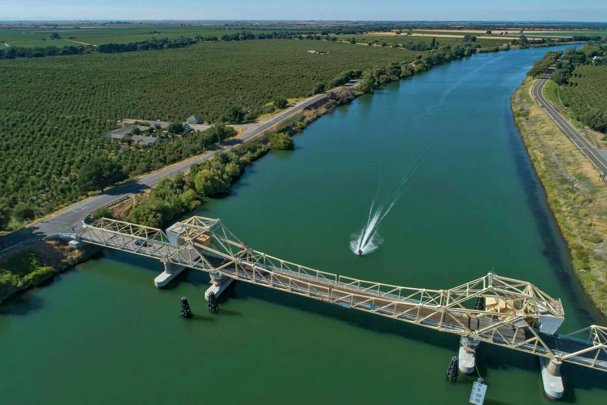
Keep Water Flowing Through the Delta
Tunnel:
Diverts fresh water from Sacramento River in northern Delta, bypassing ecosystem and in-Delta uses = less water through the Delta
Improves export water quality at expense of water quality for Delta environment and farms and communities, including NBA water supplies
Provides no incentive to DWR to maintain water quality in the Delta
Paintersville Bridge, Sacramento River near Courtland
8
Notes:
The Delta provides a common resource, including freshwater supply for cities in Solano County and Agriculture.
The actions the state is proposing has an impact on the health of the Delta, the quantity and quality of the water available to those that rely on the delta.
The state has an obligation to restore, maintain and protect the Delta including water supplies, water quality, levees and the estuary.
Delta exports disproportionately impact the environment, fish and wildlife and the users of Delta water because reduced freshwater flows impacts how the estuary works – therefore causing more determents such as HAB.
A tunnel attempts to solve water quality and supply problems for southern California and parts of the Central Valley and Bay Area but does nothing to solve water supply problems for those that are in-delta users (such as the NBA) – it makes them worse. And it provides no incentive to help protect and improve water quality in the Delta.

Slide 9
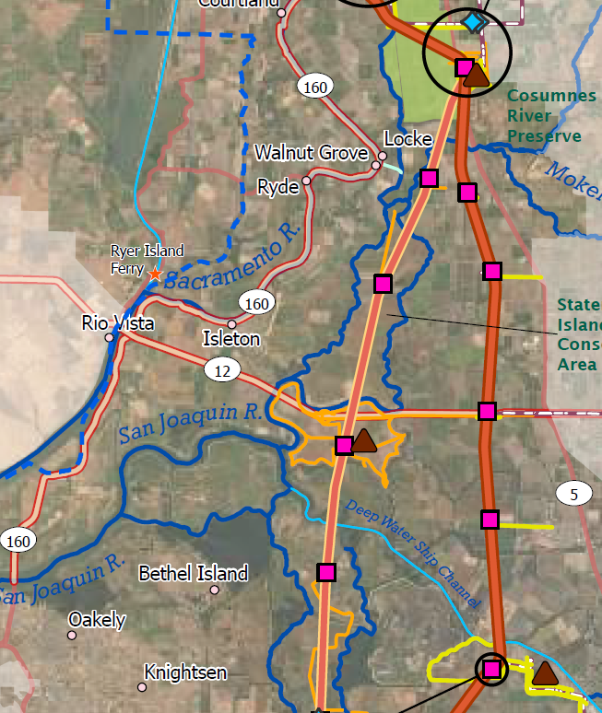
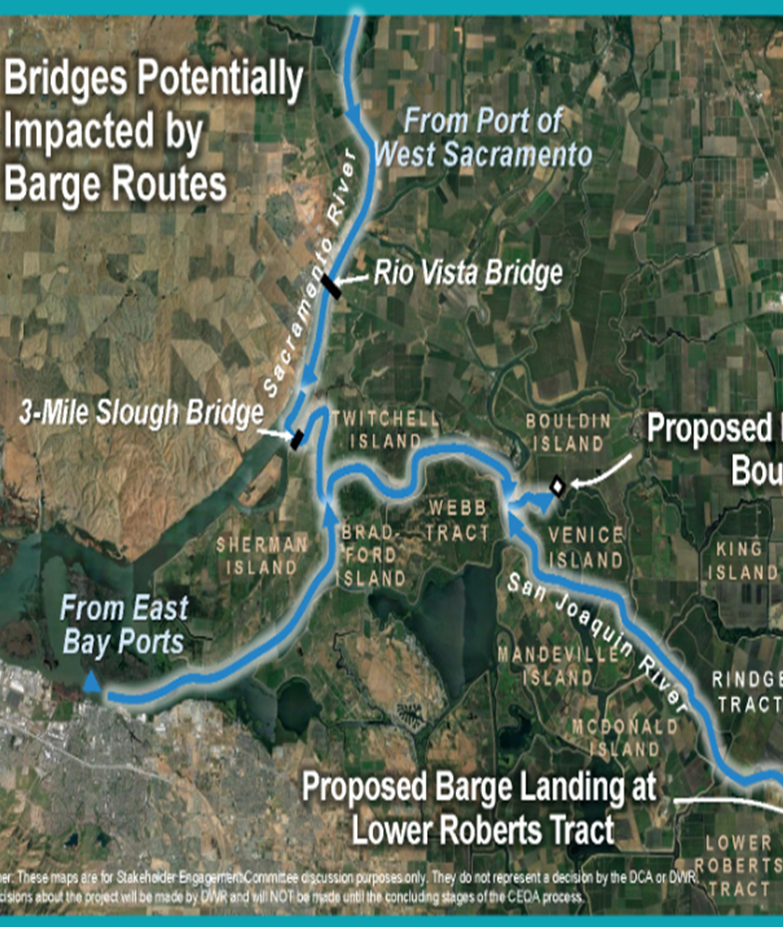
Tunnel Impacts
13 years of construction
Air quality
Noise
Road, traffic, emergency access
Community & business disruption
Economic loss

Slide 10
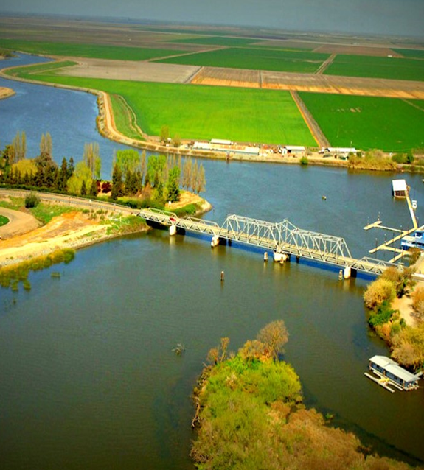
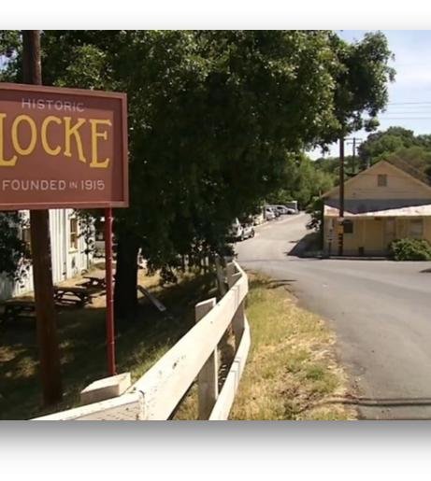
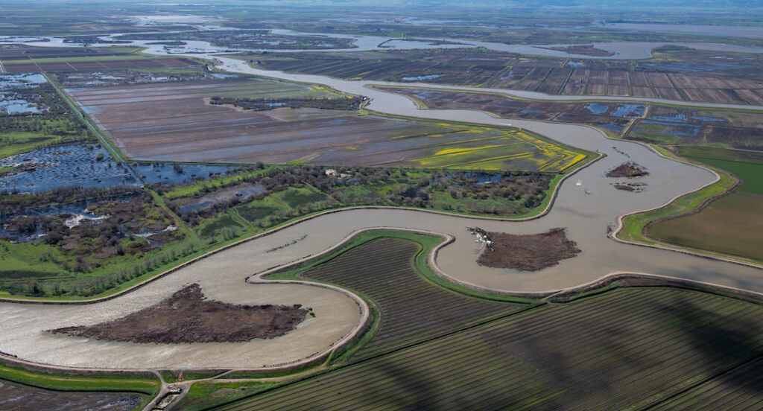
Tunnel Impacts
13 years of construction
Historical communities
Recreational & waterway impacts
Approx. 2,600 acres Agricultural Land conversions for massive intakes & accesses

Slide 11
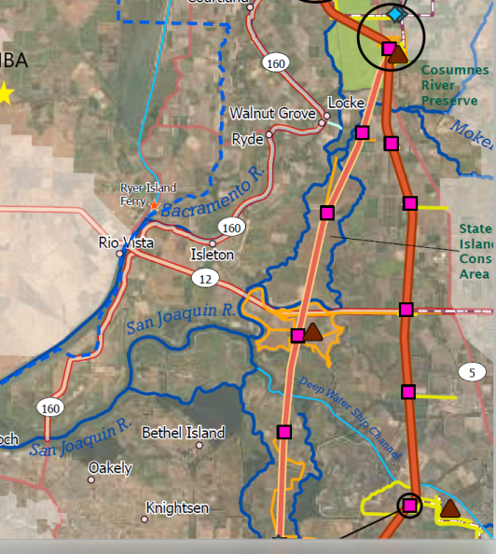
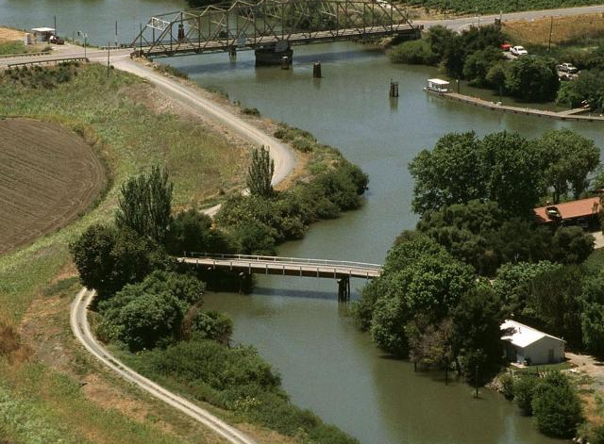
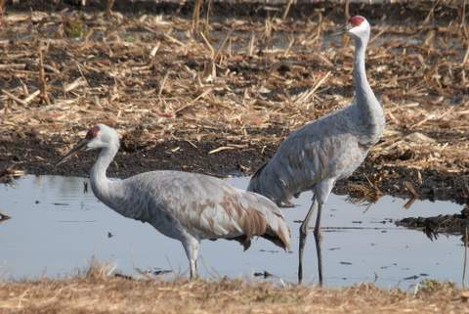
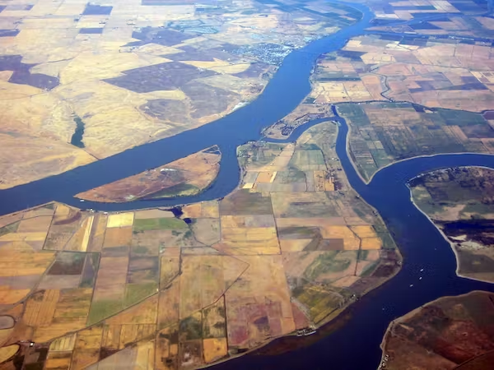
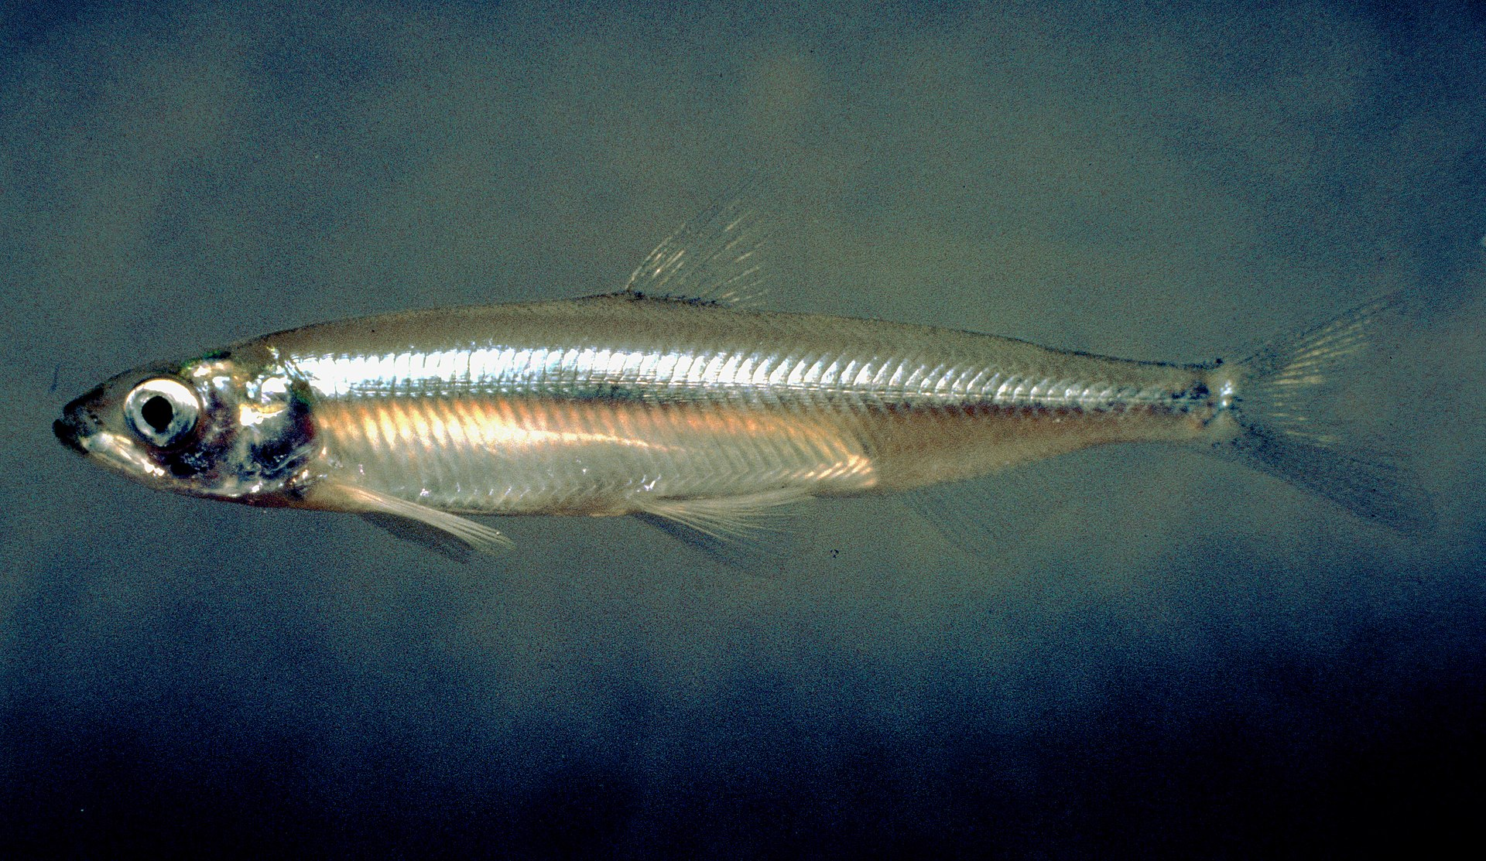
….More Tunnel Impacts
NBA
Permanent Operational Impacts:
Municipal and Agricultural water quality
Endangered species
Recreation (fishing, swimming, boating)
Social impacts to Delta communities
Additional 1,198 acres loss of Delta farmland (for habitat restoration to mitigate tunnel impacts)

Slide 12
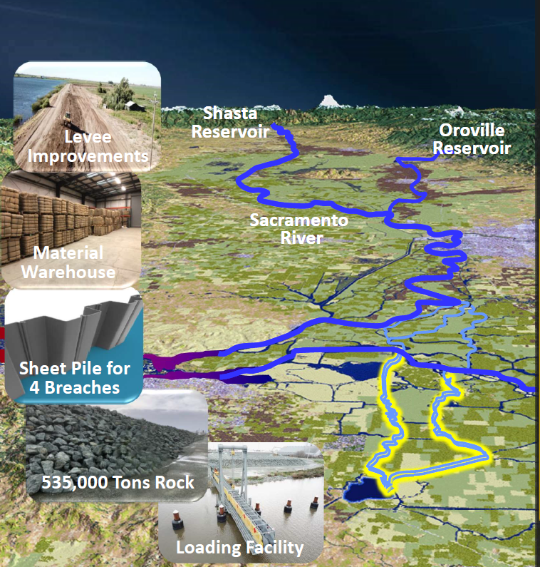
Better Alternative:
Maintain Existing Freshwater Pathway
Risk Mitigation Options
Storage Releases
Operable Barriers
Freshwater Pathway
  Pre-Event
  Levee improvements
  Material stockpiles
  Integrated plans (County, State, Fed)
  Post Event
  Repair levees
  Close side channels
  Recover < 6 months
Notes:
[explain DWR resistance to evaluate – ability to address stated needs for Delta tunnel (seismic threat, water quality threat from SLR – brackish water desal like Antioch used and elsewhere around state?)
DWR has emphasized the need to avoid loss of delivery capability due to seismic impacts, but this ignores that (1) a levee repair can be accomplished quickly and (2) southern California water agencies have 6 months or more of supply in storage that they can rely on in the event of supply disruption.
It is not the case that if a levee were to fail, Southern California would immediately lose access to all its water supply, as some key state officials have misleadingly suggested.

Slide 13
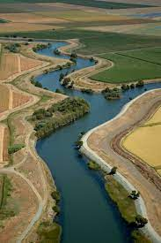
Progress Towards a Freshwater Pathway
Summary
Accomplishments
Freshwater Pathway approach included in State Emergency Response/Preparedness Plan
Regional warehouses & stockpiles completed
Regional & local Delta seismic vulnerability analyses conducted
Potential outage reduced to < 6 months
Major portions of Middle River levee improved to meet mitigate flood and seismic events
Ongoing Activities
Evaluate new levee monitoring technologies
Continue developing on-island stockpiles
Further analysis of improving Old River levees

Slide 14
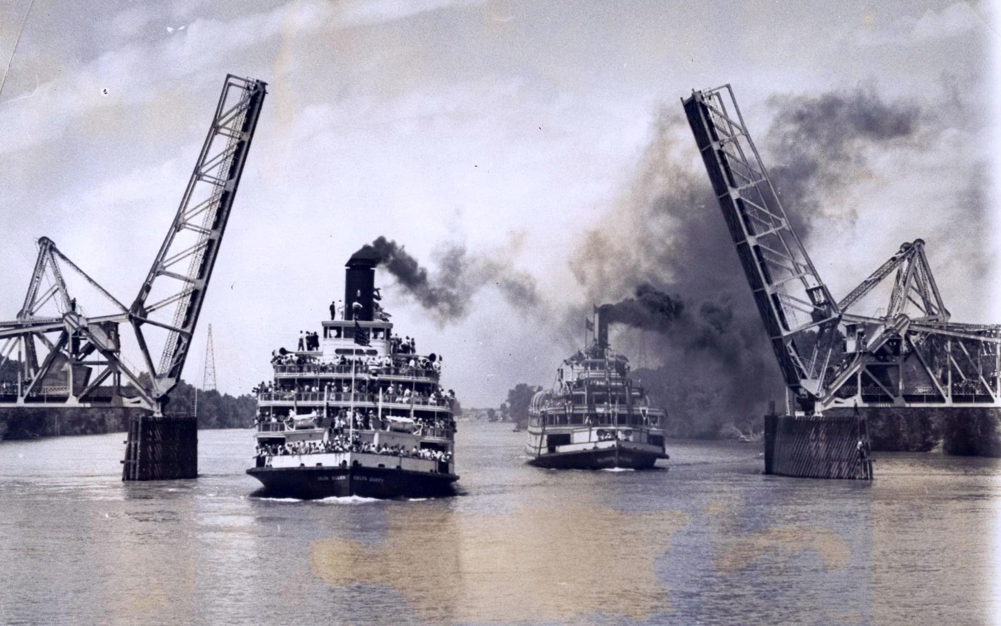
National Historic Preservation Act
Section 106
Protecting the Delta’s historic landscape
Avoiding and reducing impacts to historic properties
Delta King and Delta Queen on the Sacramento River --- 1930s
Notes:
Another opportunity to protect the Delta from damage by DWR’s tunnel is provided by the National Historic Preservation Act’s Section 106. This federal law requires the federal agency approving a project – in the case of DWR’s tunnel, that’s the Corps of Engineers – to consider ways to avoid or reduce damage to historic resources. The four Delta counties most directly affected by tunnel construction, should it be approved, have joined together with the Delta Protection Commission and some of the Indian tribes interested in the Delta to become what’s called “additional consulting parties” as the Corps considers ways to protect historic resources. This isn’t a process that can stop the tunnel, but if the tunnel is approved it will allow us to argue to for the best possible protection of the Delta landscape from a wide variety of impacts – not just damage to historic buildings and communities, but also scenic routes, historic farms, and other features, and to address a variety of tunnel construction’s damaging effects, including aesthetic impacts, noise, vibration, tunnel muck disposal, night lighting, traffic congestion, and other effects. The Delta Protection Commission is distributing a periodic newsletter to keep those who are interested informed about this effort, so if you are concerned about protecting the Delta’s historic properties you should get in touch with them at dpc@delta.ca.gov

Slide 15
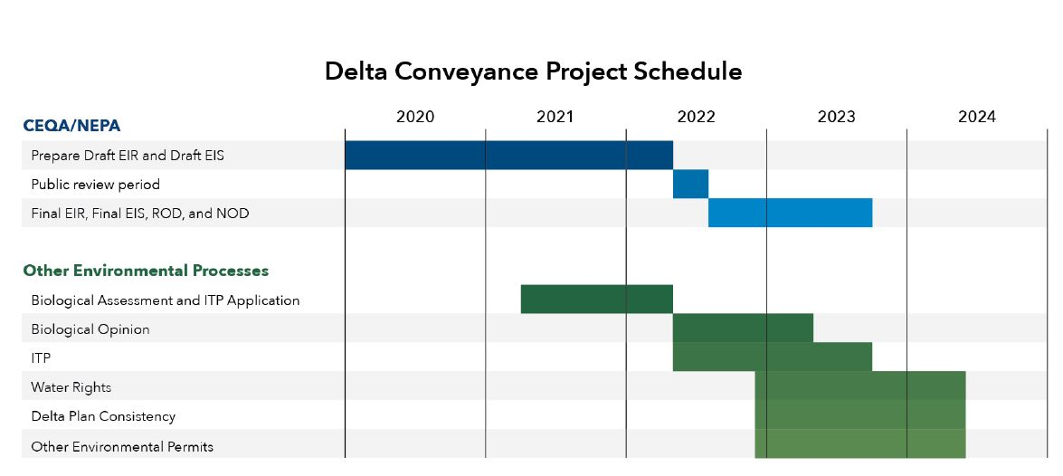
Delta Conveyance Project - Timeline
California State Department of Water Resources’ Review and Permitting
Opportunity for public input:
CEQA Public Draft – now through December 16, 2022*
* DWR extended the public comment period from Oct 27 to Dec 16 after numerous entities requested extensions.

Slide 16
Delta Conveyance Project – Draft EIR Chapters
Opportunity for public input:
CEQA Public Draft – now through December 16, 2022
Chapters | Description | Pages
Executive Summary | Overview | 119
Intro Chapters (1 – 4) | Introduction & Project Description | 239
Resource Chapters (5-35) | CEQA | 2,685
Appendices | Supporting information & documentation | 18,750
 | Approximate Total DEIR Page Count (excludes modeling & survey information) | 21,793
DEIR Document
Read the Document (deltaconveyanceproject.com)
Submit Comments: Deltaconveyancecomments@water.ca.gov

Slide 17
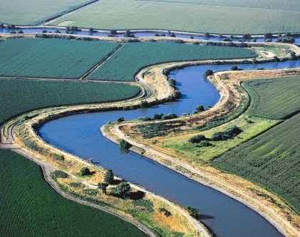
Additional References:
Department of Water Resources, Delta Conveyance Project:
Delta Conveyance Homepage (deltaconveyanceproject.com)
Delta Counties Coalition
https://delta.saccounty.gov/content/Pages/delta-counties-coalition.aspx
Restore the Delta
https://restorethedelta.org/
Save the California Delta Alliance (STCDA)
https://nodeltagates.com/
Bay Delta Live Website
https://www.baydeltalive.com/
California Data Exchange Center
https://cdec.water.ca.gov/
Water Education Foundation
https://www.watereducation.org/aquapedia/sacramento-san-joaquin-delta

